Slide 1

English
at North Baddesley Junior School

Slide 2




Supportive yet challenging
promote enthusiasm, independence, resilience
creative
Vision
motivating
North Baddesley Junior School’s
Cross-curricular
inspiring
exciting
imaginative
For English
develop pride and confidence
effective listeners and articulate communicators

Slide 3
Learning journey in English
Hook into the learning:
An experience,
A video clip,
An image,
A text.
Emersion in the text type:
Exploring a WAGOLL (examples).
Practice skills:
Practicing relevant skills e.g. sentence types, punctuation devices.
Editing:
The opportunity to edit and improve, responding to marking, checking spellings etc…
Writing:
Applying their learning to an extended write (apprentice and big writes).
Planning:
Developing their own ideas and finding inspiration.
Language development:
Broadening vocabulary and creating a word bank to support writing and spelling.

Slide 4
English from Year 3 to 6
Punctuation devices
Language devices
Sentence structure
Cohesive devices
Handwriting
Spellings

Slide 5
The language of junior English
Nouns
Adjectives
Verbs
Adverbs
Similes
Metaphors
Personification
Alliteration
Rhetorical question
Exclamation mark
Apostrophes
Semi-colons
Hyphens
Parenthesis
Brackets
dashes
Commas
Passive voice
Colons
Ellipsis
Subordinate clauses
Relative clauses
Conjunctions
Co-ordinating conjunctions
Inverted commas
Adverbials
Fronted adverbials
Synonym
Antonym
preposition
Formality
paragraphs

Slide 6
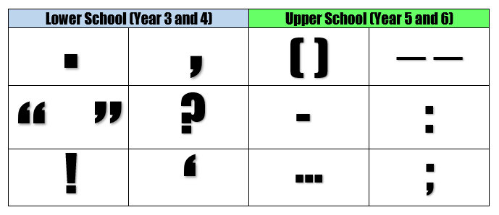
English from Year 3 to 6
Punctuation devices
Full stops
Commas
Inverted commas (speech marks)
Question marks
Exclamation marks
Apostrophes
Brackets
Dashes
Hyphen
Colon
Semi-colons
Ellipsis
*() and – aka parenthesis

Slide 7
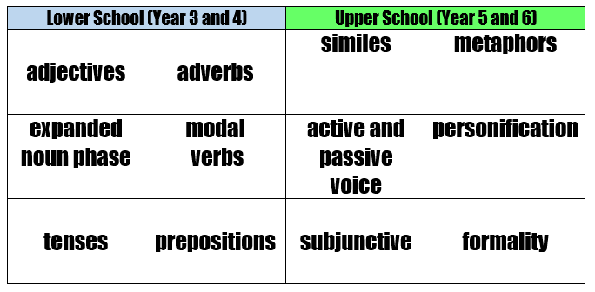
English from Year 3 to 6
Language devices

Slide 8
Nouns
A word that tells you the location of an person, place or thing.
prepositions
Words that describe an object, place, person or thing.
A word that describes an action (it may end in ly).
Adjectives
similes
Compares one thing to another using like or as.
Can you match the definitions to their meaning?
Adverbs
metaphors
Action or doing words.
Giving something natural human features.
Verbs
An object, a place, a person, a thing.
personification
Figure of speech- not literally true but helps explain through a comparison.

Slide 9
prepositions
Adjectives
similes
A word that tells you the location of an person, place or thing.
Words that describe an object, place, person or thing.
Compares one thing to another using like or as.
Nouns
Adverbs
metaphors
A word that describes an action (it may end in ly).
An object, a place, a person, a thing.
Figure of speech- not literally true but helps explain through a comparison.
personification
Verbs
Action or doing words.
Giving something natural human features.

Slide 10
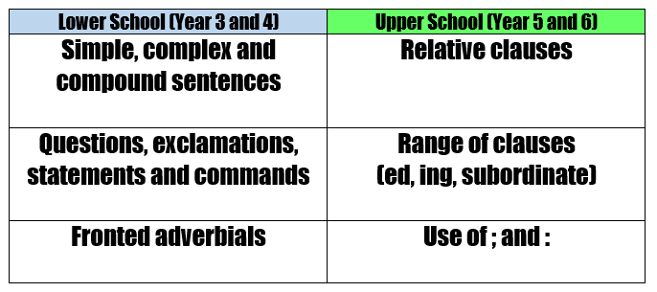
English from Year 3 to 6
Sentence structure

Slide 11
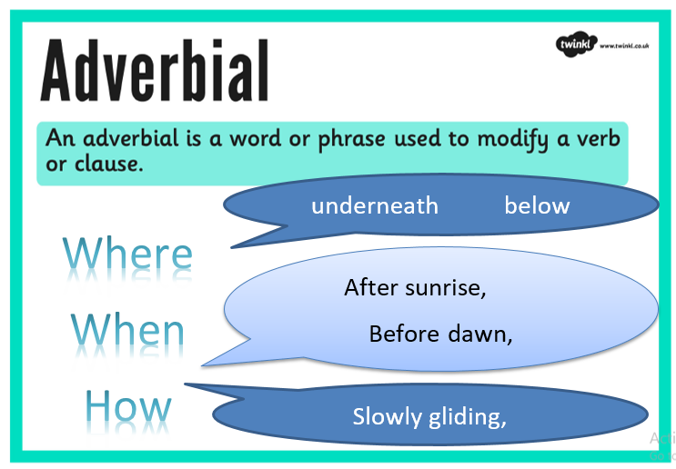
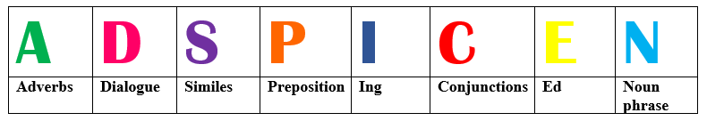
Year 4
Year 5/6

Slide 12
Where
When
How

Slide 13
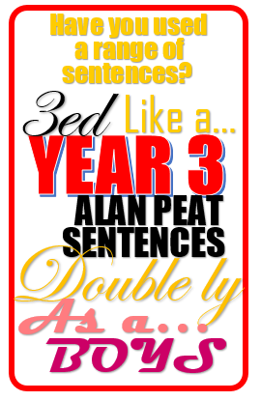
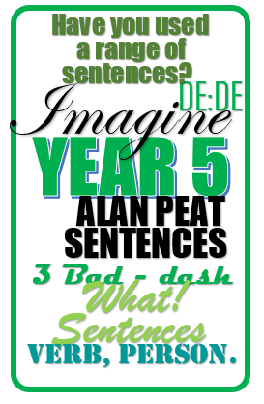
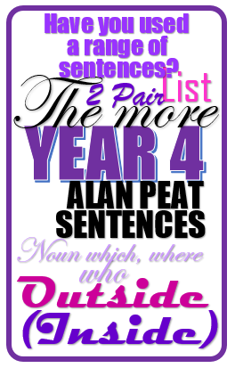
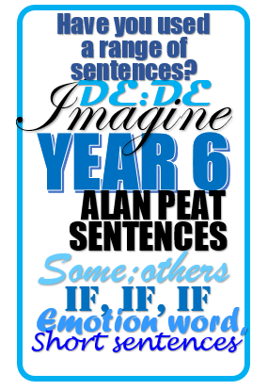
Teaching sentences through Alan Peat

Slide 14
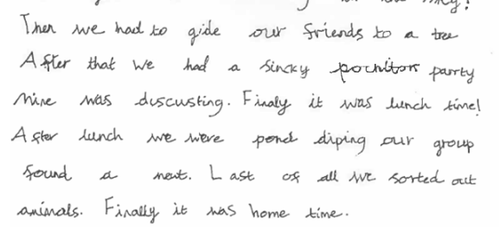
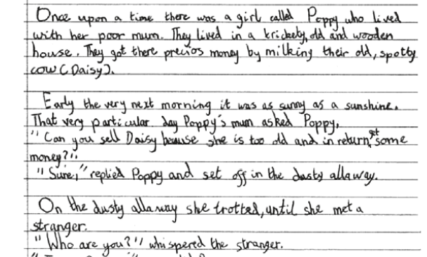
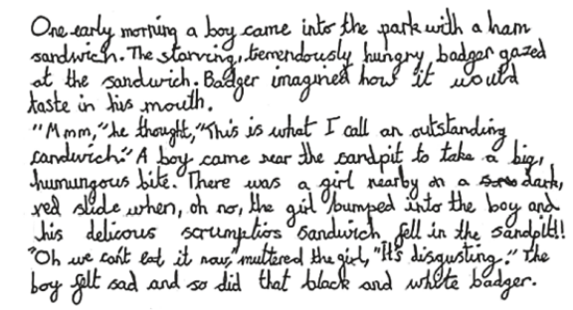
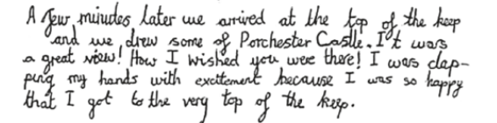
Handwriting
End of Year 2 exemplification

Slide 15
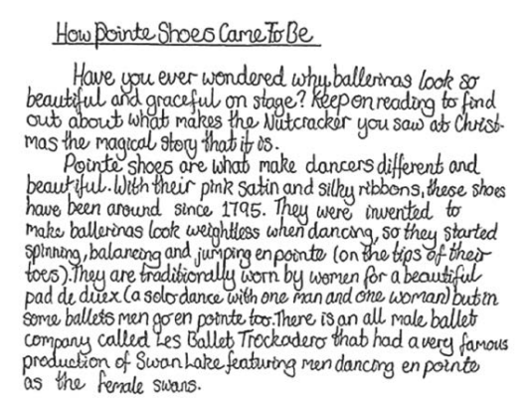
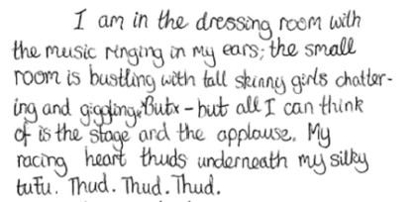
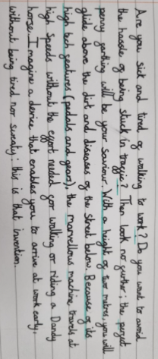
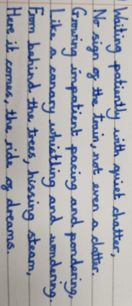
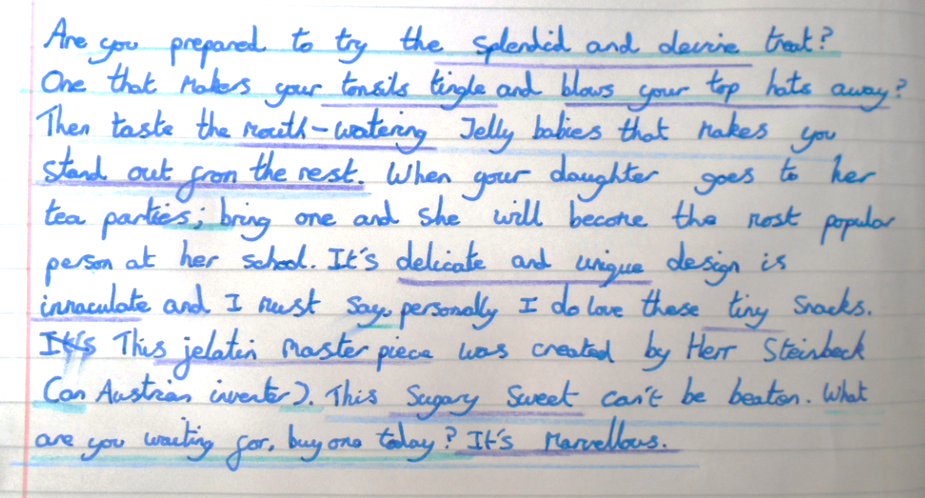
End of Year 6 exemplification
Handwriting needs to be legible and needs to be maintained at speed.
Ascenders and descenders need to be accurate, letters need to be formed fluidly and clearly.

Slide 16
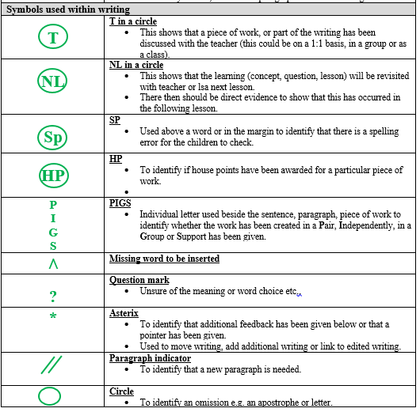
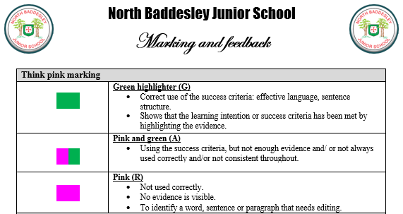
Marking
&
Feedback

Slide 17
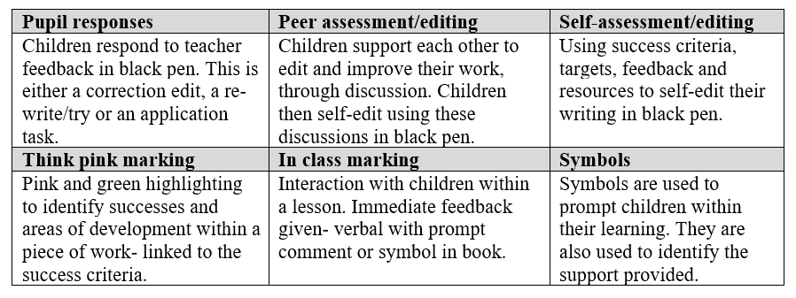

Slide 18
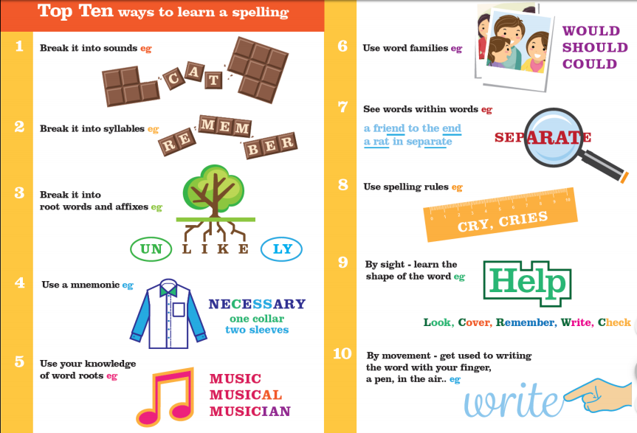
Spelling strategies
Talk about unfamiliar words when reading, commenting on their spelling.
Learning through repetition.
Learning through sight; learning through rules.
Spelling hunt when reading: can they find any words that use the rules learnt in school?
Look- cover- write check
When writing a word consider the possibilities.
Partition words to help spellings.

Slide 19
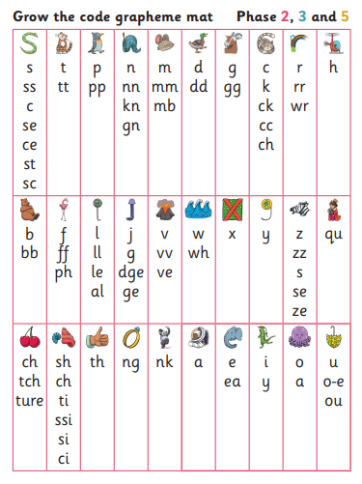
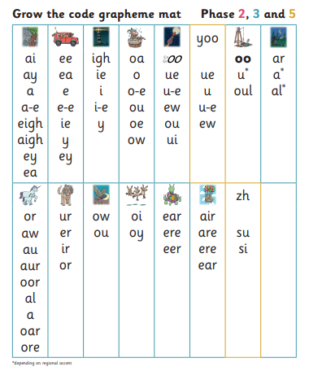

Slide 20
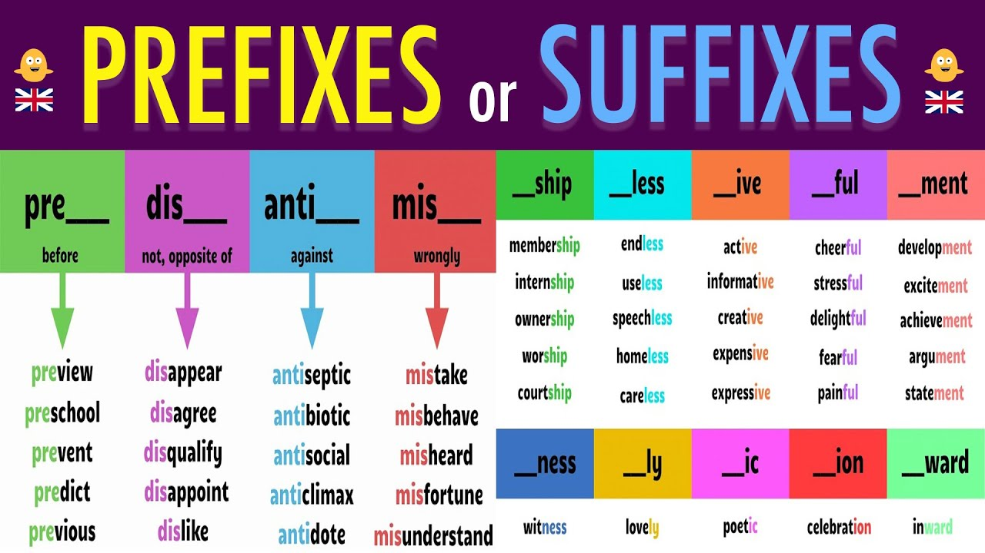
re
bi
un
il

Slide 21
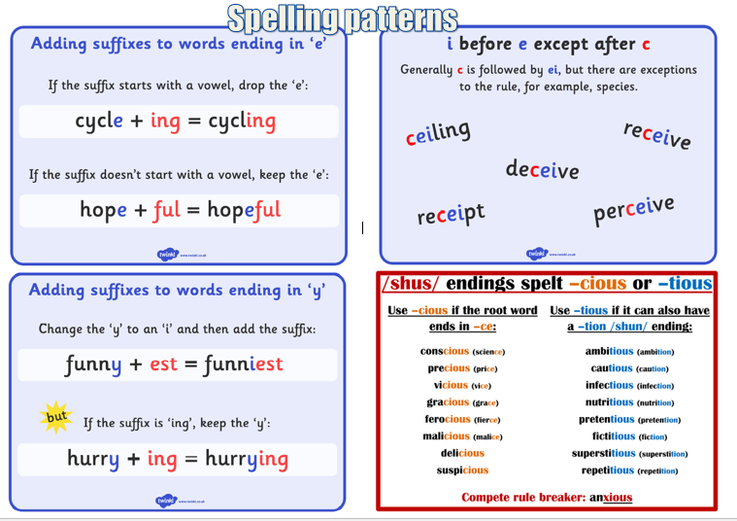

Slide 22
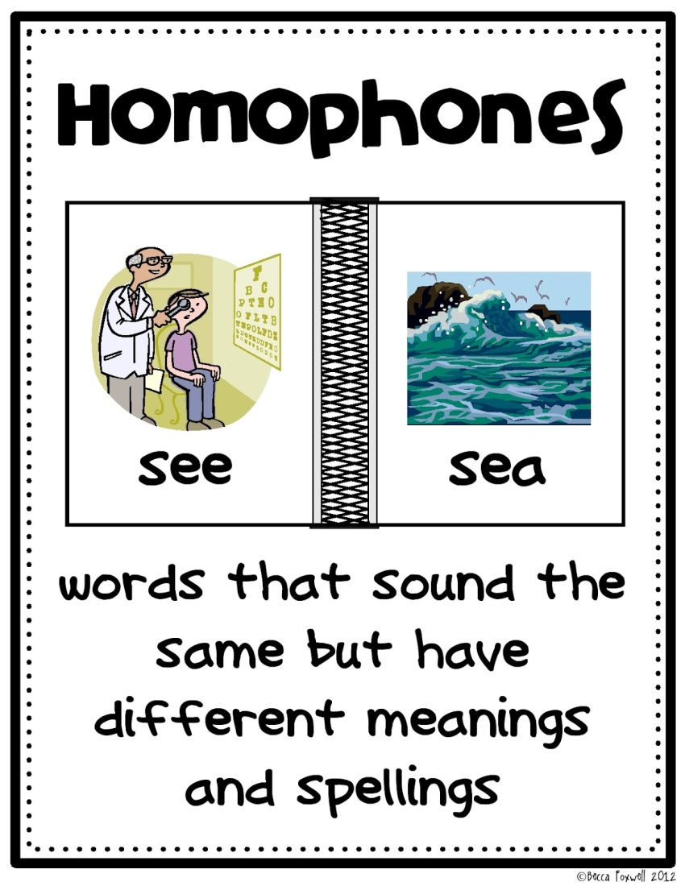
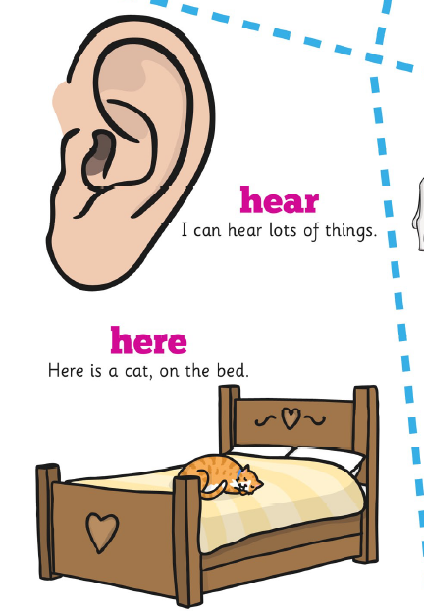
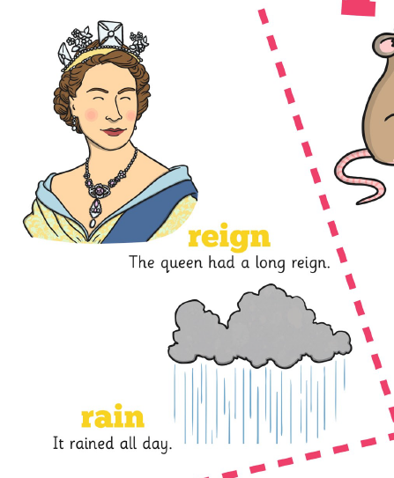
Their
There
They’re
With an ‘I’ shows that it belongs to someone e.g. their school uniforms.
With ‘here’ refers to place. e.g. look over there. There are two bicycles.
They’re = they are

Slide 23
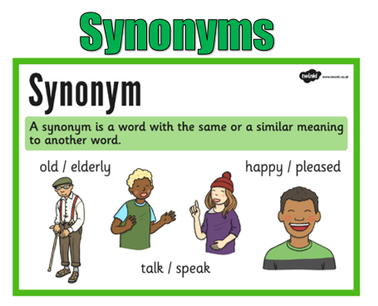
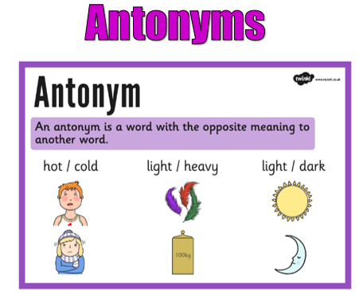

Slide 24
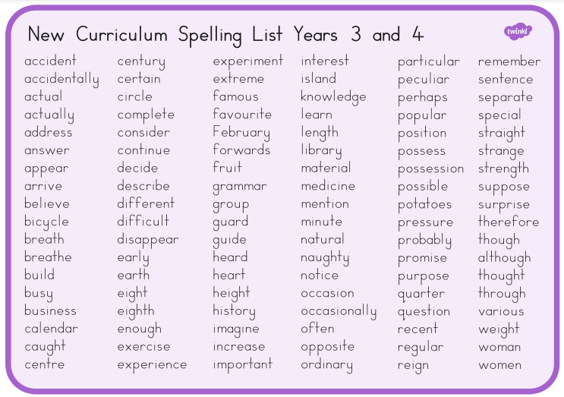
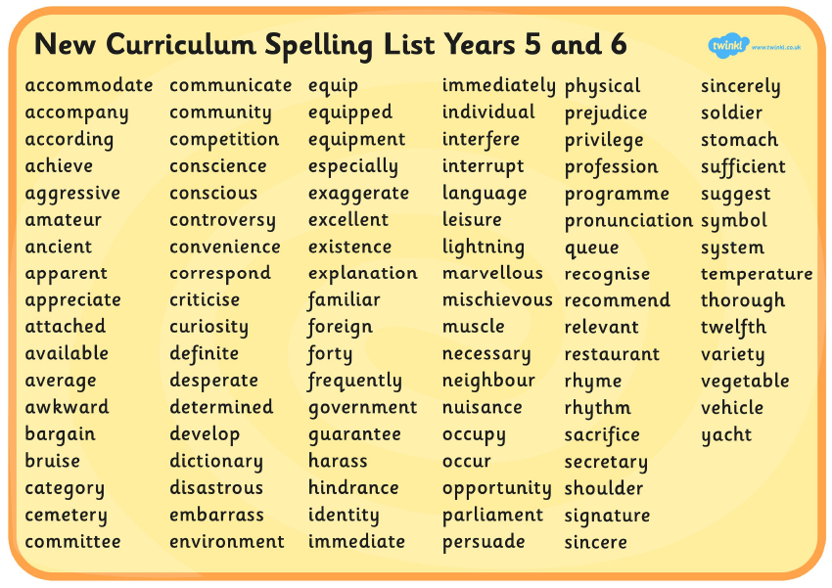

Slide 25
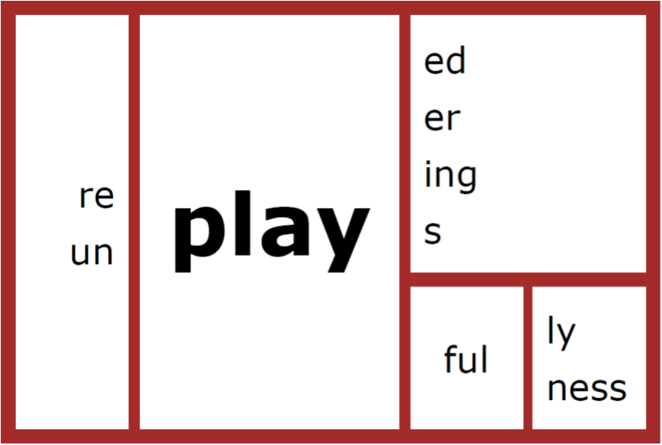
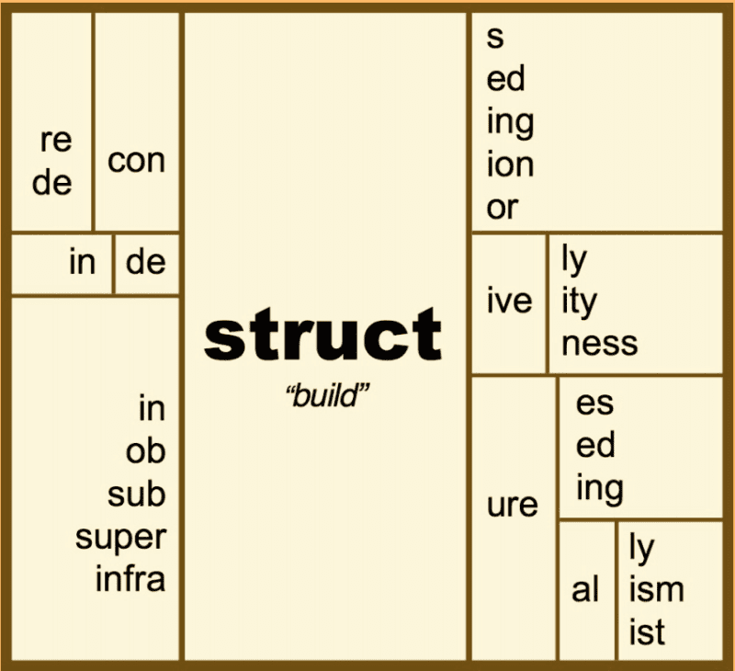
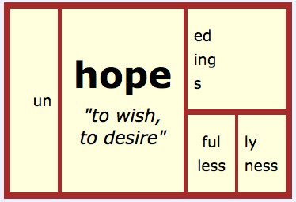
How many words can you make?

Slide 26

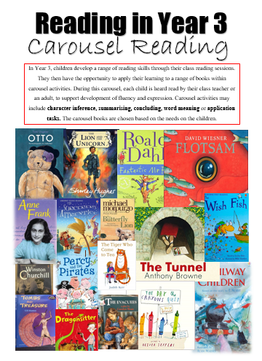


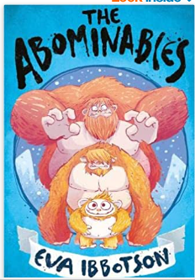










Reading in Year 3

Slide 27


Slide 28







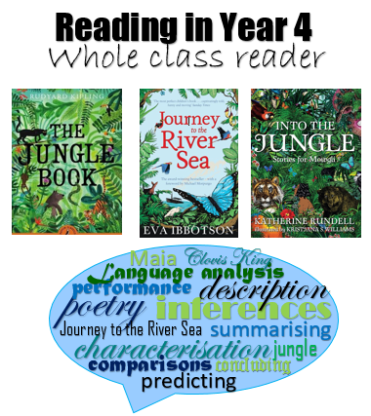
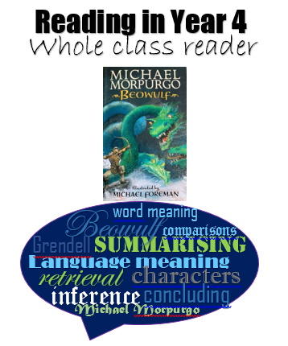









Reading in Year 4
Through class reading and home learning tasks, we focus on embedding the following skills.

Slide 29


Slide 30


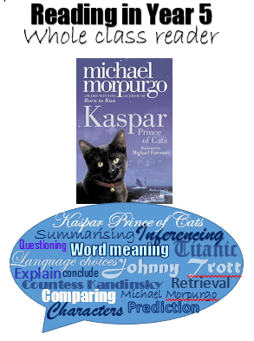
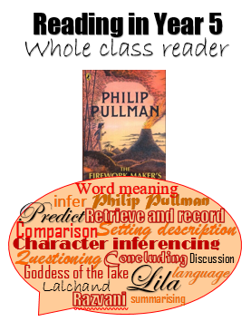
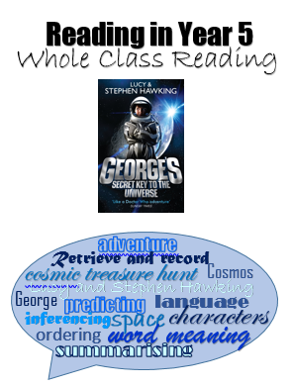


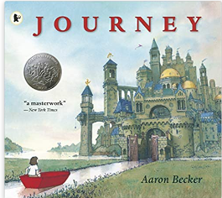



Reading in Year 5
Our reading in Year 5 is linked to our topics: Titanic, Space and the Greeks
Through class reading and home learning tasks, we focus on embedding the following skills.

Slide 31


Slide 32
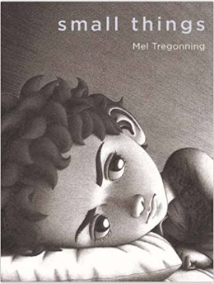



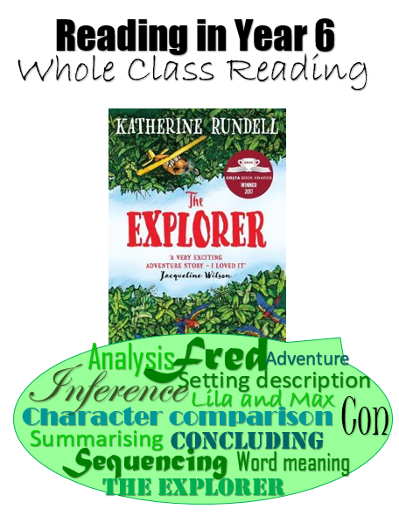
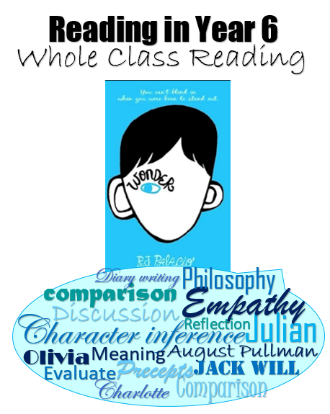





Reading in Year 6
Our reading in Year 6 is linked to our topics: a River’s Tale, Survival and Transition.
Through class reading and home learning tasks, we focus on embedding the following skills.

Slide 33


Slide 34
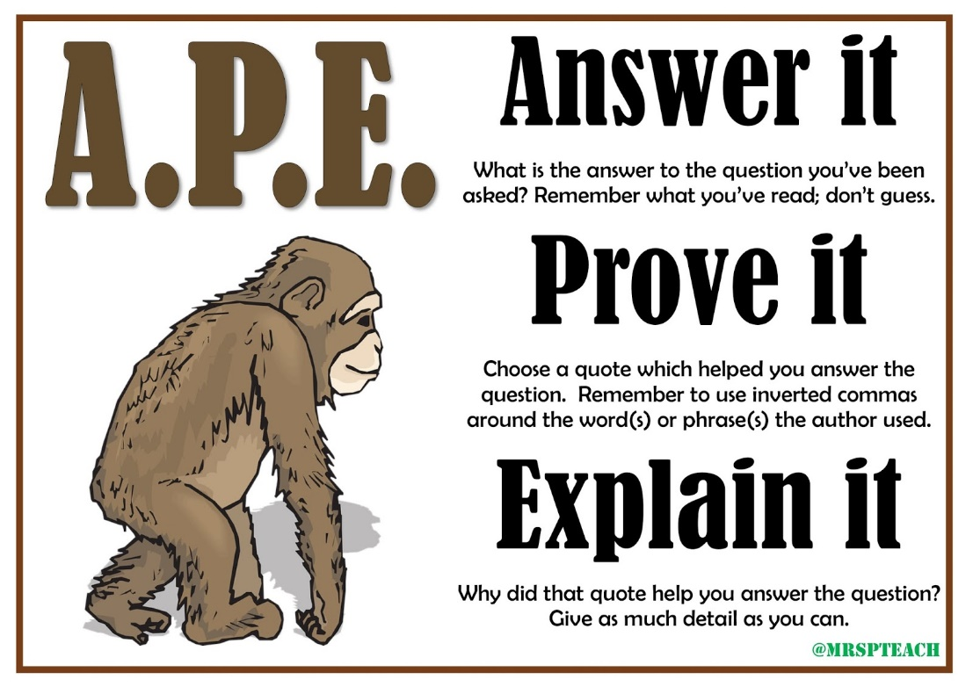
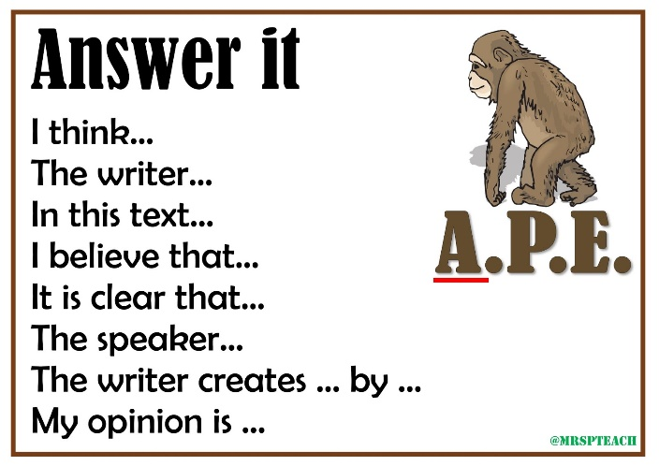
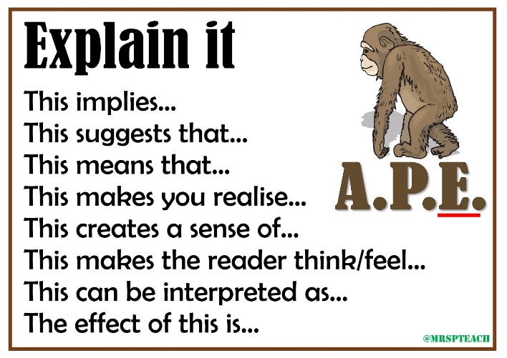

Reading- written responses

Slide 35



Slide 36


